Slide 1


Avoid AWS Lambda Cold Start

Slide 2
A cold start in AWS Lambda is the initial delay that occurs when a function is invoked for the first time or after being idle. This creates latency in responding to the first request, which is important for industry, cloud based serverless applications.
Traditional methods to avoid cold starts include provisioned concurrency. Provisioned Concurrency in AWS Lambda is a way to keep your functions warm and ready. With this feature enabled, AWS keeps some instances always running. So when a request comes, it can be served quickly without any delay. But AWS Charges for this feature.
Problem Statement
One alternative approach is to constantly ping lambda functions by invoking them at a set interval. However, this method is not cost-effective since AWS charges for the execution time of lambda functions.
The goal of the project is to avoid a cold start with minimal cost.

Slide 3
Our approach to solving this problem includes using a tiny provisioned EC2 instance.
With this approach, the request will be routed to an EC2 instance instead of directly invoking the Lambda function. Whenever a request arrives, it first checks if there is a warm (already running) Lambda function available to handle the request. If a warm Lambda function is not found, the EC2 instance will process the request itself and simultaneously trigger an event to start (cold start) a new Lambda function instance
Approach To the Problem
To track the Lambda function state, the EC2 instance marks each Lambda as warm when invoked. When a Lambda shuts down, it signals the EC2 instance. In this way, EC2 will be able to know which are warm lambdas.
We need to compare the cost and time required for this approach against other strategies. This will help us determine the effectiveness and viability of this method relative to alternative solutions.

Slide 4







# 1
Create three lambda functions.
Proof of Concept
# 2
Make a chat page to simulate traffic to the functions
# 3
Compare the costs and performance of the three approaches.

Slide 5

Three lambda functions were created
The Lambda Function
One to store the user query, one to get all user queries, and another to respond to the user query.
These were integrated with API Gateway created to invoke the functions as and when necessary.
A python script is created to always ensure cold starts so that accurate data can be gathered.

Slide 6
A rudimentary chatbot was made to demonstrate the action of the lambda functions and to allow user requests.
The User Interface
The API is called from here and the lambda functions are invoked. This serves to create the feel of a real application to simulate the usage of the product in a real setting.
A dashboard to view the function data like response time, runtime, request count and CPU and RAM usage was then built in AWS using the metrics dashboard provided by cloudwatch.
This allows us a comprehensive view of all required information, while also being convenient to access

Slide 7
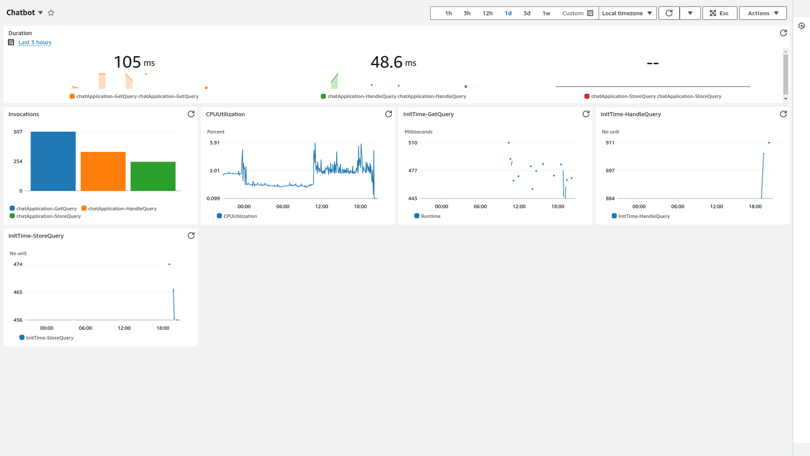
The Dashboard

Slide 8
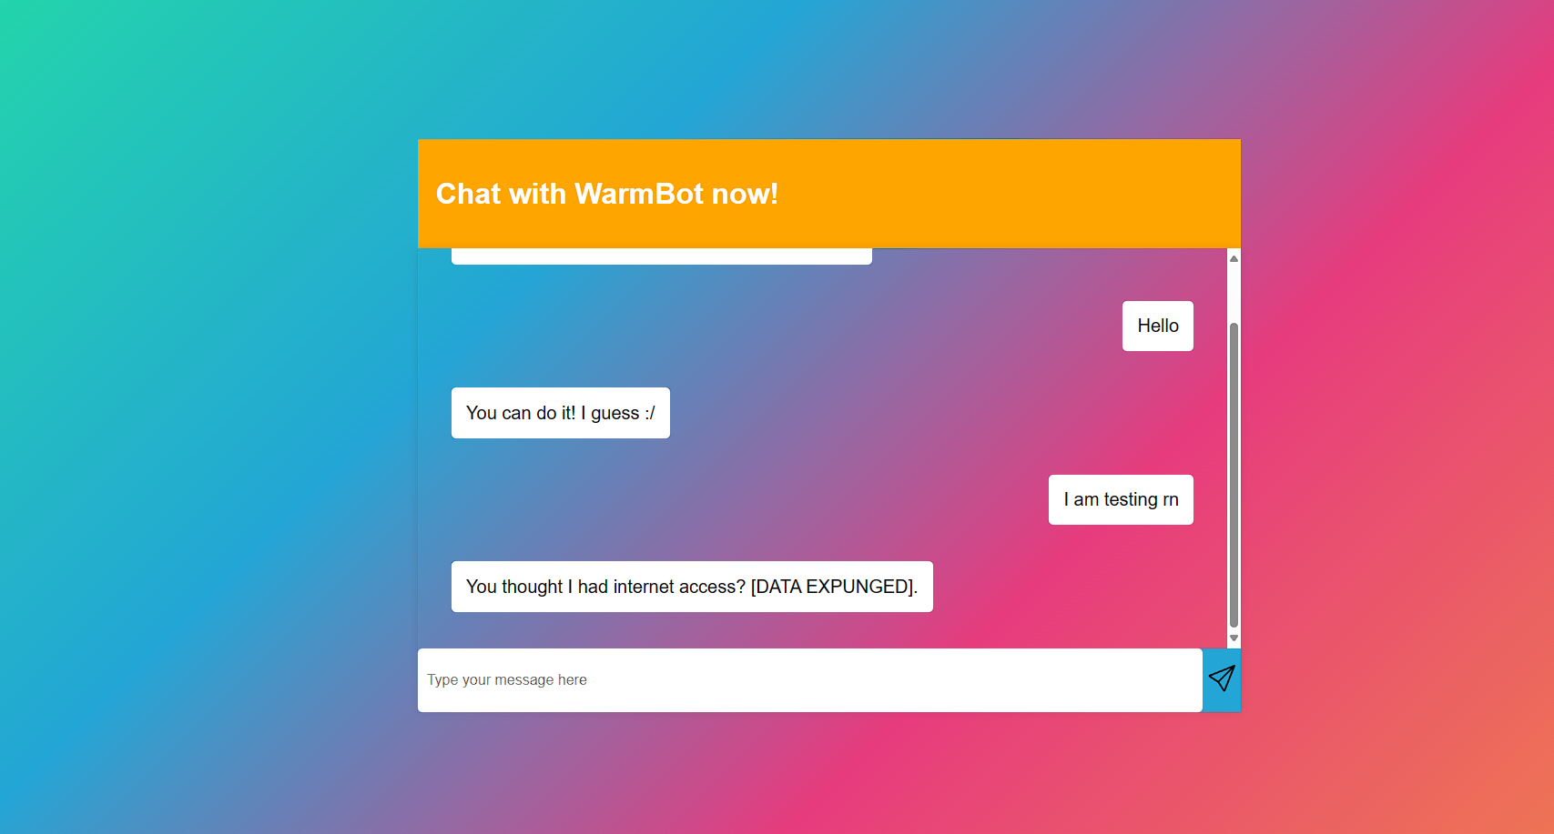
The Chat page

Slide 9
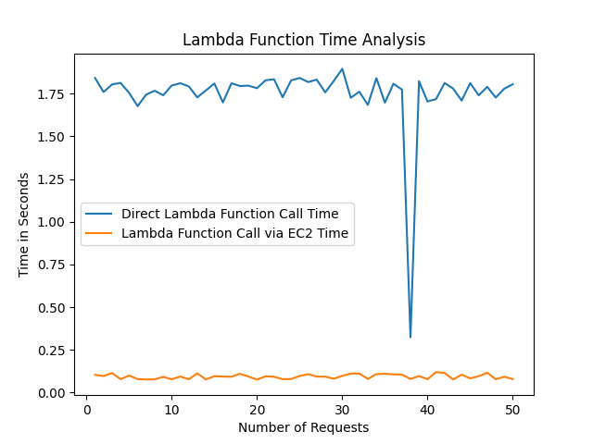
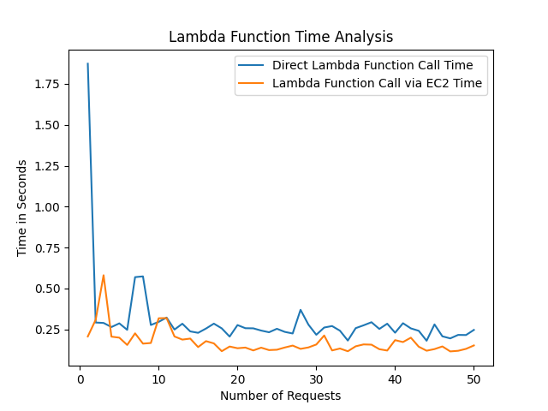
Time Analysis
For Function Getting All the Previous Queries from the DynamoDB
The left Graph shows the time difference when there is always a cold start of the lambda function and the right graph show the normal continuous query scenario

Slide 10
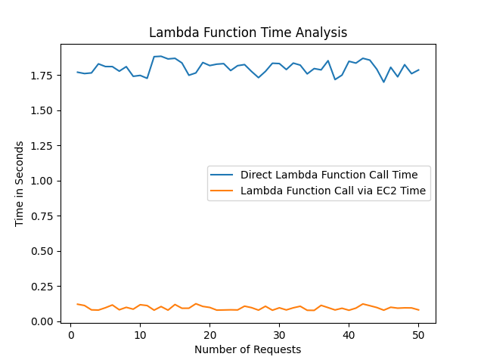
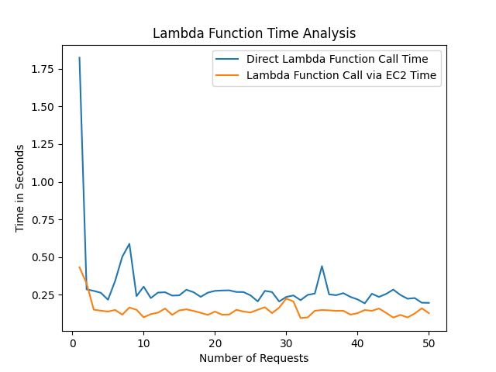
Time Analysis
For Function Storing the Query into DynamoDB
The left Graph shows the time difference when there is always a cold start of the lambda function and the right graph show the normal continuous query scenario

Slide 11
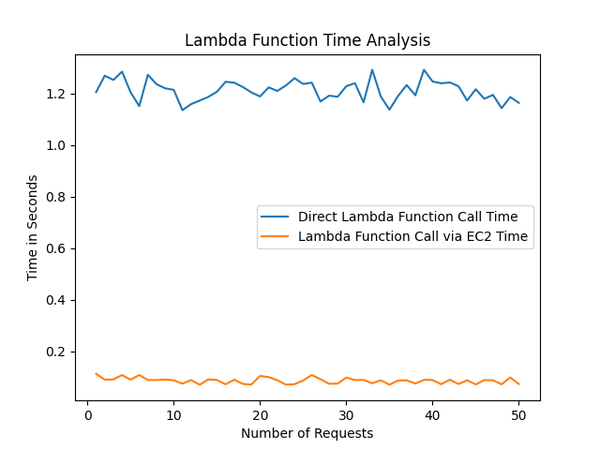
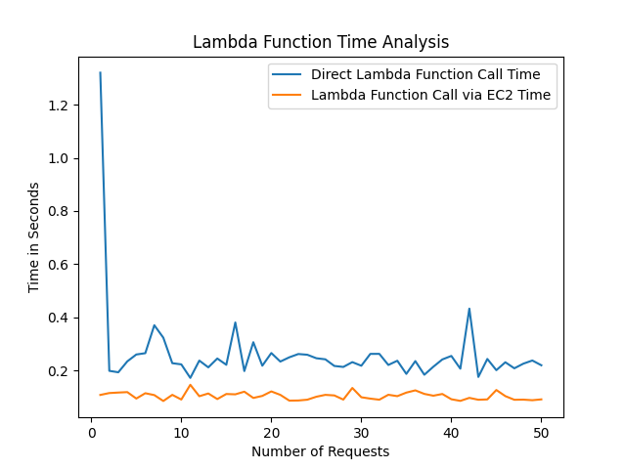
Time Analysis
For Function Getting Random Response of the query
The left Graph shows the time difference when there is always a cold start of the lambda function and the right graph show the normal continuous query scenario

Slide 12
Cost Analysis
The approach used by us will use an EC2 instance. We are considering that aws account does not have any free tier benefit so t3a.nano is a good choice for our work. This will cost around $2.26 per month and $1.39 per month with 1 year reserved plan
If we use aws feature provisined concurency then the pricing calculation will look like
assume memory size of lambda function is 512 mb and there is 1 million request per month and each execution will take approximately 150 ms time.
total time = 150ms*1000000 = 150000 seconds
Total concurrency configured (GB) = 16*512/1024 = 8 GB
Total Provisioned Concurrency amount (GB-s)= 8*150000
=1200000 GBs
Total Cost = 0.0000044985*1200000 = $5.3982

Slide 13
Cost Analysis
If we use a constantly pinging lambda function approach then the cost calculation will be like this:
Pricing for the lambda function:
if we ping the lambda function every 1/2 minute and consider the average ping time as 60 ms then the total invocation will be 60*24*30*2 = 86400. so Total lambda function execution duration = 86400*60ms = 5184000 ms.
So Total Lambda Function cost = $0.0000000083*5184000 = $0.0430272.
Now the cost of scheduling the event:
For scheduling scheduler and event bus are needed. the total cost for them will be around $2.3. so the total cost will be around $2.343 which is nearly equal to the EC2 approach but in the EC2 approach you have guaranteed warm lambda.

Slide 14
The Challenges
We were unable to test provisioned concurrency due to the high costs required, and so were unable to obtain the relevant data for this method.
Maintaining the Lambda state was a challenge, as we needed a way for Lambda to signal EC2 before shutting down. We found that AWS provides an extension API with a 500ms buffer before Lambda shutdown. During this buffer, we log a shutdown event to CloudWatch. On the EC2 side, we periodically check CloudWatch for these shutdown events to track the state of each Lambda function.

Slide 15
Limitations of the Approach
For this approach, you must be able to divide your code into subtasks that can be handled by a small EC2 instance. For example, in the chat application we considered, we were able to divide the logic into three parts: getting the queries, storing the queries, and handling the queries. These subtasks can be easily handled by an EC2 instance. However, if the functionality cannot be divided into subtasks, then this approach may not be useful.
This approach is only suitable when the normal execution time of the function is less than the Lambda cold start time. If the execution time is high, adding the few milliseconds of cold start time will have a negligible impact.

Slide 16
Video Link
https://iiitaphyd-my.sharepoint.com/:v:/g/personal/umang_patel_students_iiit_ac_in/EfC3lRoyac9Avc70vMA1o4cB4TBku_qasda2G_3EAHPtTA?nav=eyJyZWZlcnJhbEluZm8iOnsicmVmZXJyYWxBcHAiOiJPbmVEcml2ZUZvckJ1c2luZXNzIiwicmVmZXJyYWxBcHBQbGF0Zm9ybSI6IldlYiIsInJlZmVycmFsTW9kZSI6InZpZXciLCJyZWZlcnJhbFZpZXciOiJNeUZpbGVzTGlua0NvcHkifX0&e=BGWavl

Slide 17




Aravind Tearle
2022101016
Our
Team
Kavish Kapoor
2022101074
Maneesh Manoj
2022111011
Nikhil Sriram
2022114003
Umang Patel
2022101037

Slide 18



Thank You

